Slide 1
Using NBA Data To Help the Wizards Win Games
Sam Kupfer
August 8, 2019

Slide 2
Problem Statement
How can we provide better information to Washington Wizards coaches to help them win more games?
Notes:
Implied here is, “Given their limited resources…”
Winning more games -> selling tickets, merchandise, and get good players

Slide 3
Project Scope
Want this information to be actionable
So, further narrowed the scope of this project to:
How can the Wizards score more points on half-court possessions?
Offensive team has most control over these possessions, so strategy is impactful
Notes:
Brian really harped on “actionable”
These are the possessions that the offense has...
I’ll explain half-court possessions in a sec, but first I want to talk about the data I used

Slide 4
Data
NBA SportVU player tracking data from 2015-16 season
Coordinates of each player and ball are recorded 25x/second
~100mb per game
NBA play-by-play data
Information and times for each “event” – every shot, foul, etc.
Notes:
Obviously this won’t help the 2019-20 Wizards, but given access to more recent data this same analysis could be done.
Really, a lot of data

Slide 5
“Half-Court Possessions”
Possession: Period of time starting when team gets the ball and ending when opponent gets the ball
Half-court possession: Possession which lasts for at least 8 seconds after all players have crossed the half-court line
Notes:
“Half-court” here is a little arbitrary by me
And I’m only looking at the first 6 seconds of the time past half court

Slide 6
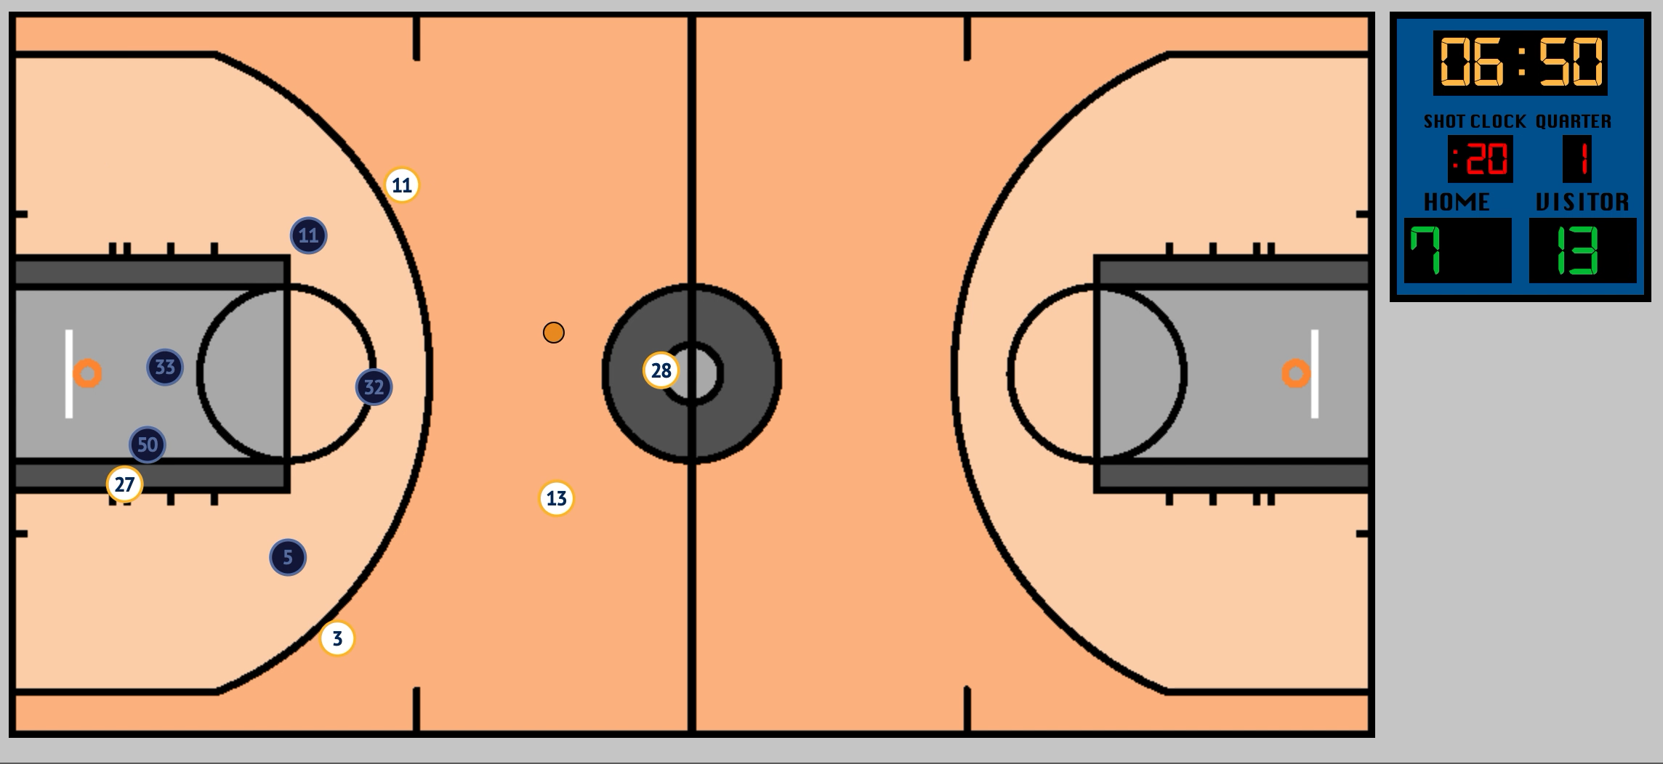
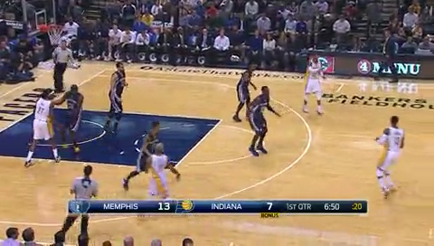
“Half-Court Possessions”
Notes:
At this point, the last player (#28) is just crossing half court (just off screen), so this is the beginning of the half court possession
On the left is the actual play, on the right is a visualization of the SportVU data
(play clips)
And now that 6 seconds have passed, this is the end of the time period I am considering
As we saw, the offense had a strategy and executed it – they made a series of passes and movements designed to create an opportunity to score
These are the types of situations that I want to focus on
But, as you can see, it is still hard to tell whether or not the offense will score on this possession

Slide 7
Project Plan
Preprocess, load, and join together data from the two sources, identifying the half-court possessions and how many points were scored on each
Cluster possessions using this data to identify common play types
Determine effectiveness of different play types so that strategy can be optimized
Notes:
So, here’s the plan

Slide 8
Project Plan
Preprocess, load, and join together data from the two sources, identifying the half-court possessions and how many points were scored on each
Cluster possessions using this data to identify common play types
Determine effectiveness of different play types so that strategy can be optimized
Notes:
Each record is one possession, which contains many timesteps (25/second). The outcome of each is the number of points that were scored on that possession
As always, this was a whole lot of work

Slide 9
Project Plan
Preprocess, load, and join together data from the two sources, identifying the half-court possessions and how many points were scored on each
Cluster possessions using this data to identify common play types
Determine effectiveness of different play types so that strategy can be optimized
Notes:
I tried a variety of methods to cluster the possessions. Time series data is tricky, I’ll get more into this soon

Slide 10
Project Plan
Preprocess, load, and join together data from the two sources, identifying the half-court possessions and how many points were scored on each
Cluster possessions using this data to identify common play types
Determine effectiveness of different play types so that strategy can be optimized
Notes:
Are there plays that the Wizards use a lot that are ineffective?
Are there plays that they don’t use that are more effective?

Slide 11
Project Plan
Preprocess, load, and join together data from the two sources, identifying the half-court possessions and how many points were scored on each
Cluster possessions using this data to identify common play types
Determine effectiveness of different play types so that strategy can be optimized
Notes:
First step

Slide 12



Data Preprocessing
SportVU player tracking data
Play-by-play data
Notes:
QUICK!
It was a whole lot of data. I created a whole database schema in PostgreSQL, using python to extract the data, transform, process, and put it into a bunch of tables
The SportVU data was only available for ½ the season, but I only used data from about 15% of the season (227 games), which was still a lot
The data was really messy. The data was scraped from visualizations on NBA’s website; I’m sure the data that teams get is much cleaner, but, gotta work with the data you have
Issues like missing time periods, teams not going the direction they’re supposed to, players changing mid-play, etc.

Slide 13
Project Plan
Preprocess, load, and join together data from the two sources, identifying the half-court possessions and how many points were scored on each
Cluster possessions using this data to identify common play types
Determine effectiveness of different play types so that strategy can be optimized
Notes:
I tried a variety of methods to cluster the possessions. Turns out it’s tricky to cluster complex, time series data

Slide 14
Clustering Possessions
How to assess “goodness” of clusters?
Sum of squared errors – average distance between each sample and the center of their cluster
Silhouette score – calculated using distances between sample and others in same cluster, and distances between sample and others in next-nearest cluster
Most importantly, do they make sense?
Notes:
Kmeans and other clustering algorithms seek to minimize SSE. In this case, the distance between each sample and the center of the cluster they belong to
Silhouette often used for selecting # of clusters
(b – a) / max(a, b) where a = mean intra-cluster dist, b = mean nearest-cluster dist
Also others
Keeping in mind the goal of the project – to measure effectiveness of play types. The clusters need to ”mean” something that can be understood and articulated by humans - me, a coach, a player
If you can't actually describe what kinds of players are in each cluster, the coach won't be able to use the outputs help the Wizards

Slide 15
Clustering Possessions
Most clustering algorithms require data to be “flat” – one row of N features for each sample – to determine distance
How to extract “flat” features from time-series, image-like data? Neural networks!
CNN’s are good for images…RNN’s are good for time-series data…
Notes:
Kmeans etc. require one “flat” row of features per sample
But with more than 2 features
The distance between (1, 1) and (4, 4) is $\sqrt{{\left(4−1\right)}^{2}+{(4−1)}^{2}}=\sqrt{18}$

Slide 16
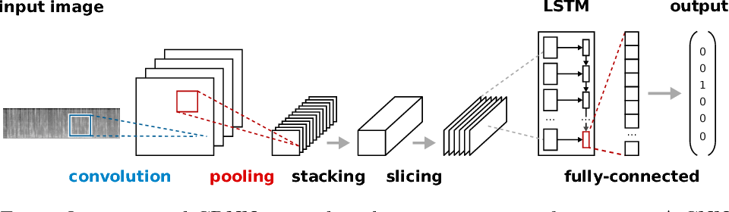
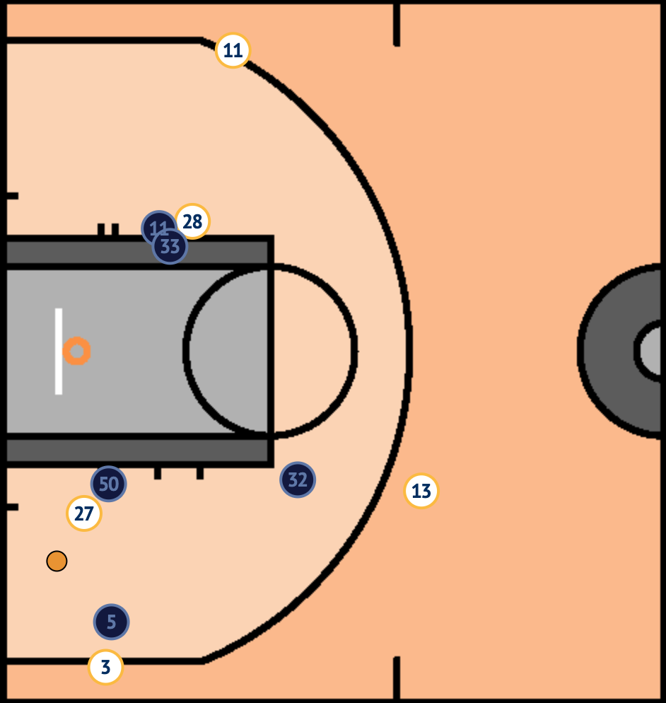
CRNN (Convolutional Recurrent Neural Network)
50
feet
Outputs
(1 row per possession)
150 timesteps
47 feet
Backpropogate
(silhouette score loss function)
Notes:
I spent a lot of time trying this
Convolution network extracts information from each image in the sequence, passed into LSTM.
The LSTM will learn what information to “forget” and what to “remember” with each passing time step.
The outputs from the LSTM will be one row per possession – just what we need for Kmeans.
And hopefully, these rows will have features that contain meaningful information about the possession
They will be passed to the Kmeans clusterer, which will cluster them and calculate the silhouette score, which is a measure of how “good” the clusters are.
This (well, 1 – this) will be the loss function, so that we can teach the network to produce features that contain information that leads to the best clusters!

Slide 17
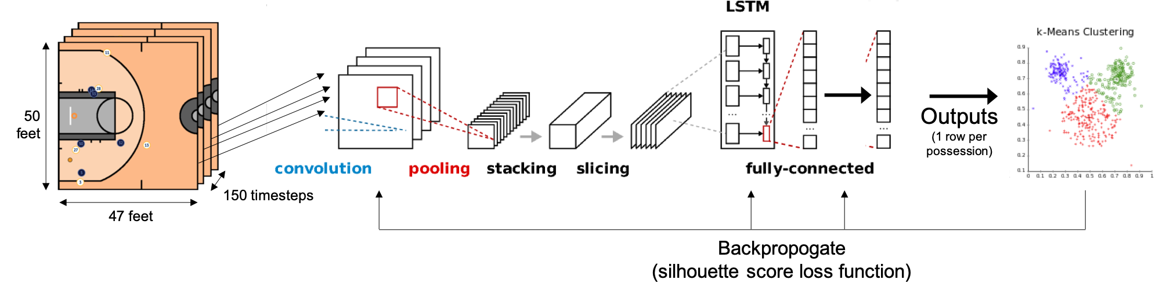
CRNN (Convolutional Recurrent Neural Network)
Not enough memory to run a sufficient number of samples through the network in one batch…
If only 100 samples are being put into 10+ clusters, there is a lot of randomness and learning is difficult
Notes:
100 samples not enough to do 10+ clusters, end up with some clusters having only a few samples, silhouette score is very unstable and the network didn’t learn

Slide 18
Feature Engineering
Angle between each offensive player, all other offensive players, ball, and basket
Notes:
Ditched the neural networks and started with some more manual feature extraction

Slide 19
Feature Engineering
Angle between each offensive player, all other offensive players, ball, and basket
As well as the distance between each offensive player, all other offensive players, ball, and basket
Notes:
Plus a couple other things

Slide 20
Feature Engineering
Angle between each offensive player, all other offensive players, ball, and basket
As well as the distance between each offensive player, all other offensive players, ball, and basket
Now use K-means?
Unfortunately, had way too many features
Notes:
Got these features at each timestep, combined them all into one big row per possession.
Each row had 57 features for each timestep (I reduced to 30 timesteps, 5 per second)
So 1710 features in each row. Didn’t work well
Tried reducing this with PCA, still didn’t work well

Slide 21
Time Series Clustering
Methods exist specifically for time series clustering!
Dynamic time warping similarity – a measure of distance between two time series
Makes “time series K means” clustering possible
Notes:
Yes, that’s the real name
It’s complicated but I’ll try to explain

Slide 22
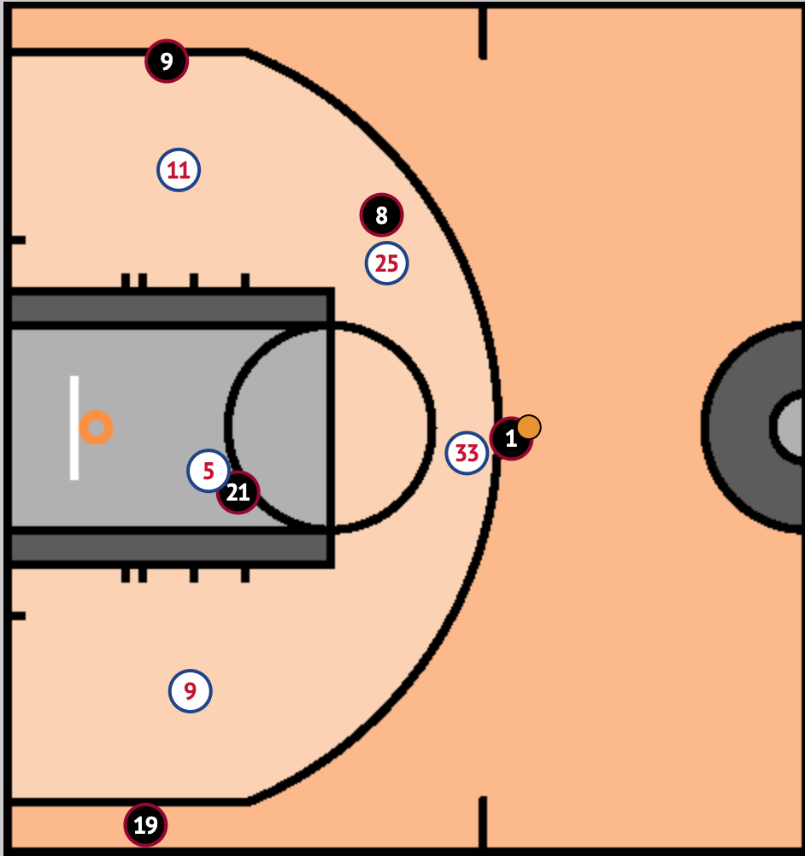
Calculate difference between
T₁
T₁
T₂
T₂
Calculate difference between
P₁
P₂
Notes:
With regular K Means like I was trying, each feature was being compared to the same feature at the same timestep

Slide 23
Notes:
If X and I are doing jumping jacks, and we’re not in sync – I’m up while he/she’s down and vice versa –regular K Means thought those two actions were very different
But time series k means saw that they were very similar

Slide 24
Notes:
If X and I are doing jumping jacks, and we’re not in sync – I’m up while he/she’s down and vice versa –regular K Means thought those two actions were very different
But time series k means sees them as very similar
Now, Results!!

Slide 25
Calculate difference between
T₁
T₁
Calculate difference between
T₂
T₂
Calculate difference between
Calculate difference between
P₁
P₂
Notes:
With regular K Means like I was trying, each feature was being compared to the same feature at the same timestep
With time series K Means, features are compared across time steps as well

Slide 26
Project Plan
Preprocess, load, and join together data from the two sources, identifying the half-court possessions and how many points were scored on each
Cluster possessions using this data to identify common play scenarios
Determine effectiveness of different play types so that strategy can be optimized
Notes:
Now that I’ve clustered the possessions…

Slide 27
Results: League
Cluster | Description | Points per Play | % of Plays
3 | Swing left->right | 1.113 | 9.2%
2 | Slow on-ball screen | 1.101 | 6.1%
12 | Guard pass and cut | 1.090 | 5.9%
4 | Slow double-screen/cluster | 1.088 | 5.5%
0 | Quick on-ball screen | 1.040 | 6.7%
6 | 5-out | 1.035 | 7.2%
8 | Various things on left side | 1.035 | 6.9%
9 | ?? | 1.030 | 5.5%
7 | Double on-ball screen | 1.028 | 7.8%
13 | Off-ball screens in the paint | 1.027 | 7.9%
10 | “Wheel” action | 0.989 | 8.1%
1 | ?? | 0.984 | 8.0%
5 | ?? | 0.958 | 7.3%
11 | 3-4 players screening at FT line | 0.947 | 8.0%
N=7,931
Notes:
With that method, got better clusters
Most of them made sense, some more than others. Very far from perfect, but still interesting and I think useful. Some of the ???’s are broken plays
I just looked at some of the plays and noted what I saw in common. Trends were hard to find in a few clusters
For each, I have the average points for plays in that cluster, and the percentage of plays that belonged to that cluster. Sorted by PPP
Plays on which the ball was passed around the 3 point line, left to right, were most effective.
Plays with multiple players clustered around the FT line were the least effective
Worth keeping in mind: In 2015-16, the best offense in the league averaged 1.14 PPP. The worst averaged 0.99 PPP. So the difference between the top and bottom of this list is very big

Slide 28
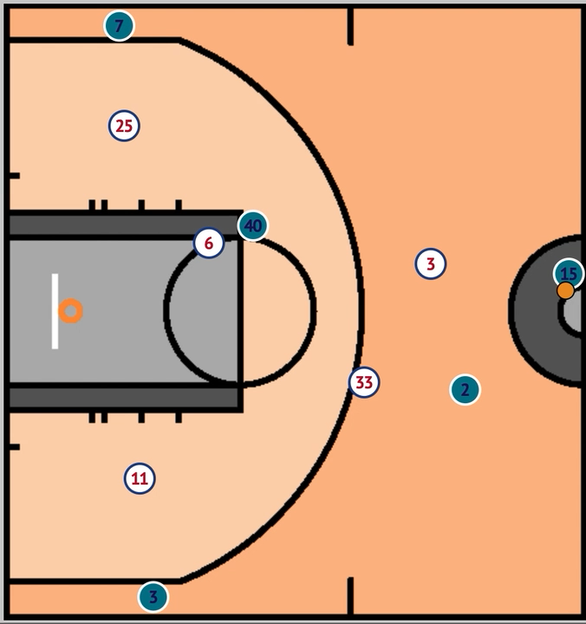
Cluster 7: Double On-Ball Screen
Notes:
These are the closest and 2nd closest plays from this cluster to it’s center. So, the ones that are most emblematic of this cluster

Slide 29
Results: Wizards
Cluster | Description | Points per Play* | N | % of Plays
3 | Swing left->right | 0.75 ± 0.723 | 12 | 5.2%
2 | Slow on-ball screen | 0.667 ± 2.868 | 3 | 1.3%
12 | Guard pass and cut | 1.4 ± 0.769 | 10 | 4.3%
4 | Slow double-screen/cluster | 1.062 ± 0.599 | 16 | 6.9%
0 | Quick on-ball screen | 1.125 ± 0.503 | 24 | 10.3%
6 | 5-out | 1.0 ± 1.194 | 7 | 3.0%
8 | Various things on left side | 0.933 ± 0.532 | 15 | 6.5%
9 | ?? | 1.0 ± 0.491 | 25 | 10.8%
7 | Double on-ball screen | 1.208 ± 0.542 | 24 | 10.3%
13 | Off-ball screens in the paint | 0.333 ± 0.564 | 12 | 5.2%
10 | “Wheel” action | 0.947 ± 0.567 | 19 | 8.2%
1 | ?? | 0.963 ± 0.418 | 27 | 11.6%
5 | ?? | 1.033 ± 0.444 | 30 | 12.9%
11 | 3-4 players screening at FT line | 2.0 ± 0.774 | 8 | 3.4%
N=232
* 95% conf. int.
Notes:
Now, how does all this apply to the Wizards?
Very small sample here, so including the 95% confidence intervals for points per play. Can’t put much stock in those
% of plays run is still worth noting though. Let’s compare to league

Slide 30
Results: Wizards vs. League
N=232
* 95% conf. int.
Cluster | Description | Points per Play* | (relative to league) | N | % of Plays | (relative to league)
3 | Swing left->right | 0.75 ± 0.723 | -0.363 | 12 | 5.2% | -4.0%
2 | Slow on-ball screen | 0.667 ± 2.868 | -0.434 | 3 | 1.3% | -4.8%
12 | Guard pass and cut | 1.4 ± 0.769 | 0.310 | 10 | 4.3% | -1.6%
4 | Slow double-screen/cluster | 1.062 ± 0.599 | -0.025 | 16 | 6.9% | 1.4%
0 | Quick on-ball screen | 1.125 ± 0.503 | 0.085 | 24 | 10.3% | 3.7%
6 | 5-out | 1.0 ± 1.194 | -0.035 | 7 | 3.0% | -4.2%
8 | Various things on left side | 0.933 ± 0.532 | -0.101 | 15 | 6.5% | -0.4%
9 | ?? | 1.0 ± 0.491 | -0.030 | 25 | 10.8% | 5.3%
7 | Double on-ball screen | 1.208 ± 0.542 | 0.181 | 24 | 10.3% | 2.6%
13 | Off-ball screens in the paint | 0.333 ± 0.564 | -0.694 | 12 | 5.2% | -2.7%
10 | “Wheel” action | 0.947 ± 0.567 | -0.042 | 19 | 8.2% | 0.1%
1 | ?? | 0.963 ± 0.418 | -0.021 | 27 | 11.6% | 3.6%
5 | ?? | 1.033 ± 0.444 | 0.075 | 30 | 12.9% | 5.7%
11 | 3-4 players screening at FT line | 2.0 ± 0.774 | 1.053 | 8 | 3.4% | -4.6%
Notes:
Compared to the rest of the league, the Wizards:
Used the top 3 plays (in terms of league PPP) less than the league average! This seems bad
Very limited sample size, so it’s hard to gauge their effectiveness running these types of plays
And they used some of the plays that are least effective throughout the league often
They find themselves in the ?? Categories, some of which are “broken” plays/weird situations, often. This might say more about their players than their strategy.

Slide 31
conclusions
Clustering time-series data requires special methods but can be done effectively
The Wizards should try to use some of the more effective strategies (league-wide) more often:
Passing the ball around the 3 point line
Taking their time setting slow, precise on-ball screens
Maybe slow down and try their best to avoid weird situations

Slide 32
Questions?
I learned a lot doing this project!

